Slide 1
SALARY AND COMPENSATION ANALYSIS THROUGH EXCEL DATA MODELING
STUDENT NAME: V.DHARANI
REGISTER NO:312200835
DEPARTMENT: B.com general
COLLEGE: Pachaiyappas college for women
Kanchipuram

Slide 2
PROJECT TITLE
SALARY AND COMPENSATION ANALYSIS THROUGH EXCEL DATA MODEL

Slide 3


AGENDA
Problem Statement
Project Overview
End Users
Our Solution and Proposition
Dataset Description
Modelling Approach
Results and Discussion
Conclusion
3/21/2024 Annual Review

Slide 4

PROBLEM STATEMENT
Unlike most private companies, foundations and charities must be ready to prove to the IRS that they are not overpaying their employees. If your organization uses a documented process to determine whether compensation is reasonable, it will be more difficult for the IRS or anyone else to challenge it. As an added bonus for public charities and certain other types of exempt organizations, such documentation puts the burden of proving the compensation is unreasonable on the IRS.
If you do not document that process, the IRS is in the driver's seat-and you might not like where they take you. They can levy stiff penalties against an officer or director who received the compensation and managers, including board members, who approved it. Such incidents must be reported publicly on Forms 990 or 990-PF, potentially tarnishing the trust of donors, media, and the public.
What is a compensation study?
A compensation study considers the job requirements, location, size of the organization, and other facts to provide a reasonable range of compensation for that position in a given market. Through our long experience in the not-for-profit sector, Clark Nuber has created a highly efficient, thorough, and cost-effective process for documenting reasonable compensation, which defends the amount or, for public charities and certain other types of organizations, pushes the burden of proof on the IRS.

Slide 5
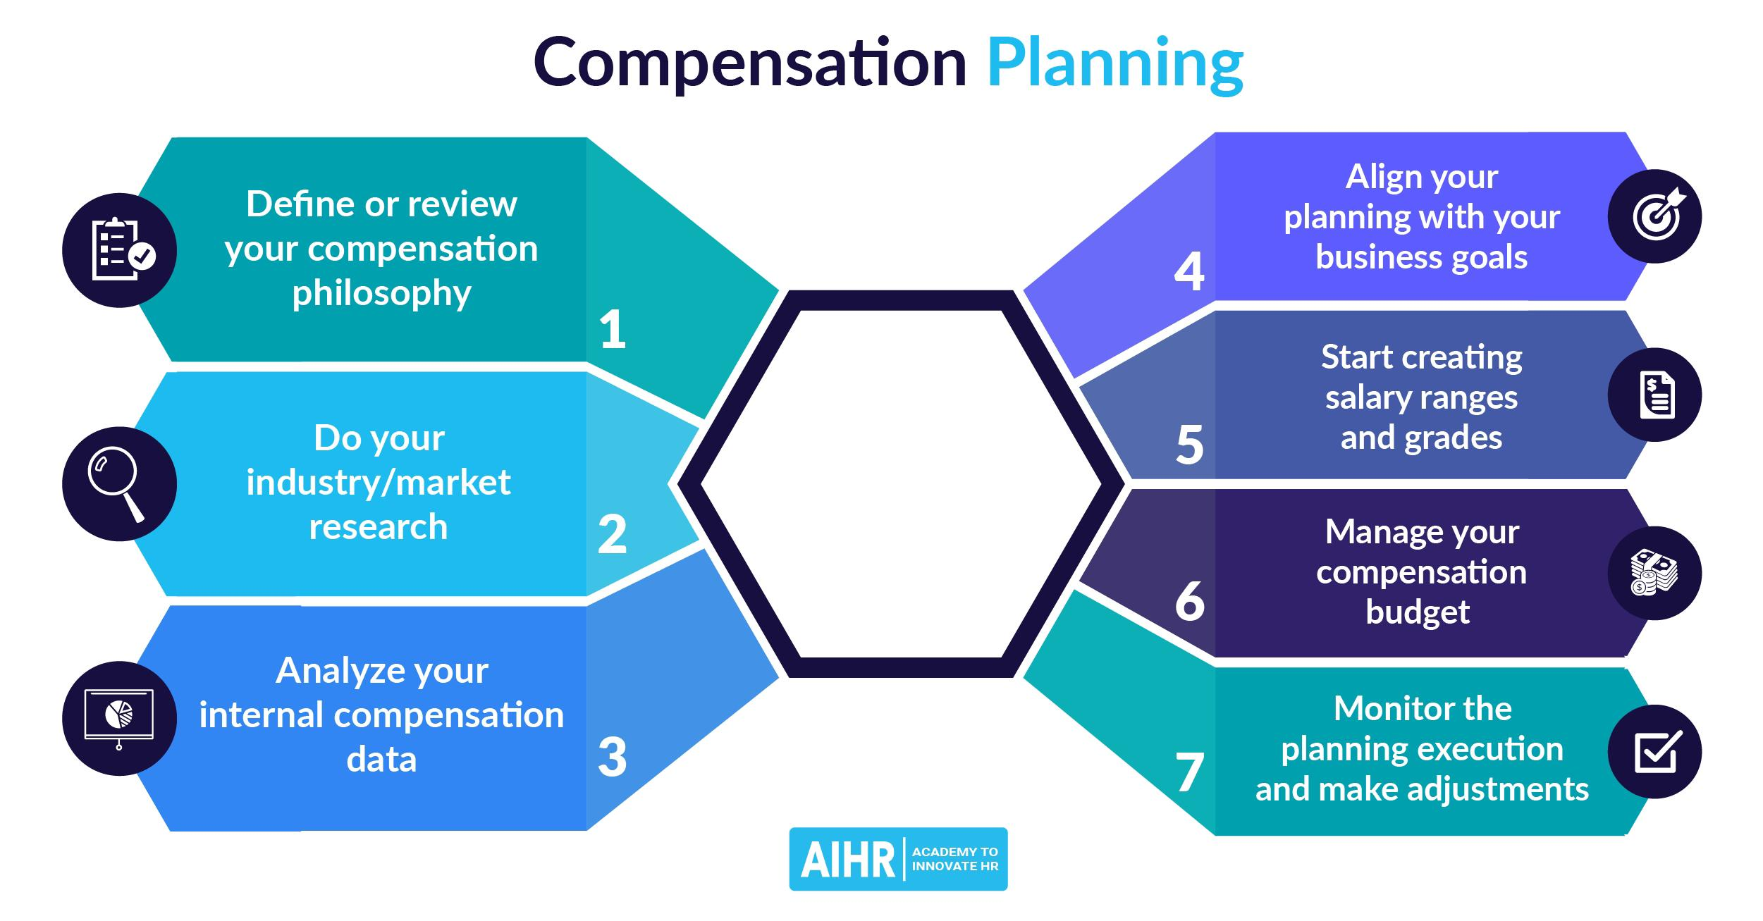

PROJECT OVERVIEW
.

Slide 6

WHO ARE THE END USERS?
The end users of salary and compensation analysis are employees and the organization as a whole:
Employees
Compensation analysis helps ensure that employees are paid fairly and competitively, both internally and externally.
Organization
Compensation analysis helps organizations make informed decisions about how to pay employees, and can help them attract and retain top talent.
Compensation analysis can help organizations:
Understand market trends
Compensation analysis helps organizations understand what other organizations are paying their employees, and how they can stay competitive.

Slide 7

OUR SOLUTION AND ITS VALUE PROPOSITION
Compensation analysis can help organizations in many ways, including:
Attracting and retaining top talent
Compensation analysis can help organizations ensure they are offering competitive pay to attract and retain top talent.
Maintaining legal compliance
Compensation analysis can help organizations ensure they are compliant with labor laws and regulations.
Fostering fairness and equity
Compensation analysis can help organizations ensure that employees are paid fairly and equitably, both internally and externally.
Managing budgets
Compensation analysis can help organizations monitor salary expenses and prevent overpayment or underpayment.

Slide 8
Dataset Description
Salary and compensation analysis datasets are a type of business-to-business (B2B) data that can include information on salaries, benefits, and other compensation offered to employees. They can also include information on demographics, contracts, and market competition.
Here are some places to find salary and compensation analysis datasets:
Kaggle: Has datasets such as the Employee Salary Dataset and salary_data of Employees with years of Experience
Data.world: Has 24 compensation datasets

Slide 9
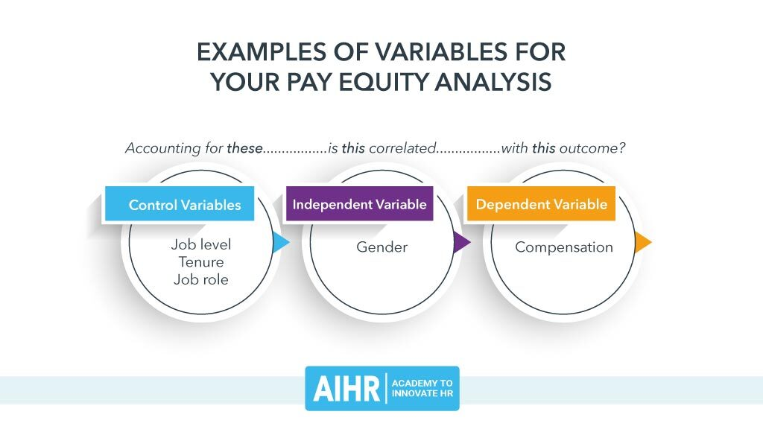

THE "WOW" IN OUR SOLUTION
3/21/2024 Annual Review
9

Slide 10
MODELLING
Some types of compensation models include:
Location-agnostic pay: All employees are paid the same, regardless of location.
Localized compensation: Pay is adjusted based on the cost of living and average salaries in a specific region or city.
Performance-based compensation: Employees receive a base rate, plus additional bonuses based on their performance.
10

Slide 11
MODELLING
Salary and compensation analysis modeling helps organizations determine how to compensate employees, and can include:
Compensation models
A framework that defines how an organization pays employees, including base salary, benefits, and variable pay. Compensation models help organizations attract and retain talent, while also complying with employment laws and balancing labor costs.
Compensation analysis
A process that compares salaries to determine if they are competitive, equitable, and cost-effective. Compensation analysis can consider factors such as location, level, and equity.
Salary range modeling
A process that involves testing out different models and regularly reassessing them.
Data analytics
A process that uses data-driven insights to help organizations make informed decisions about compensation.
11

Slide 12
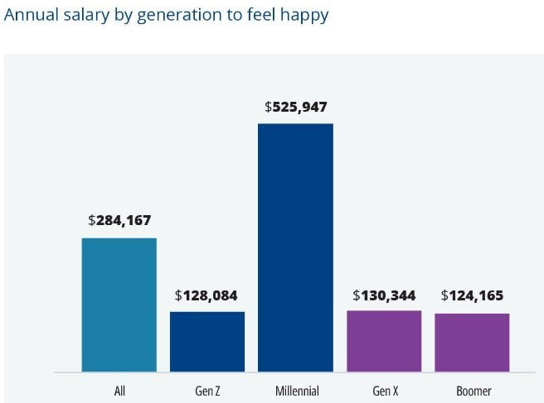
RESULTS
12

Slide 13
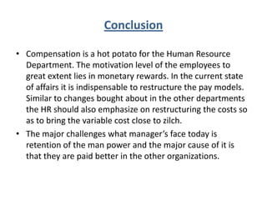
conclusion

